Slide 2
Mettle is the communications agency behind the BLOODHOUND Project, responsible for all aspects of media management and content creation.
In November 2014, we staged a media and documentary filming event at Hakskeenpan, South Africa, where the car will run in 2015 and 2016. The event focused on a test of BLOODHOUND's high speed communication infrastructure and the announcement of Jaguar as the Project's new partner.
Despite the event taking place in the Kalahari Desert, 1000 km from major media centres, significant coverage was secured across all major South African media channels, including live, on-location breakfast television and radio broadcasts over two days, plus major news reports and features on television news, national, regional and local print media, radio and digital news platforms
In-country AVE is calculated at R4.2 million (c.£250 000).

Slide 6
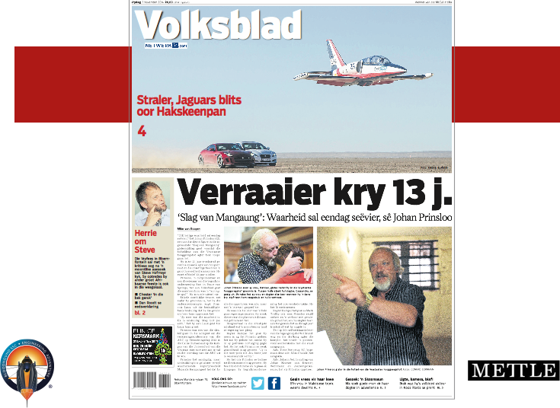

Slide 7
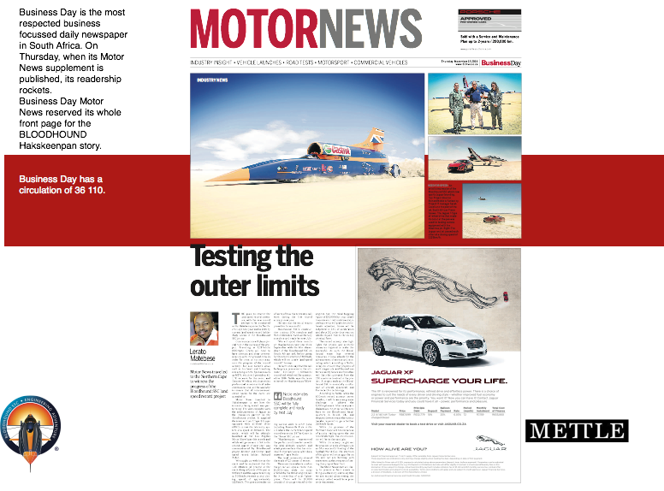

Slide 9
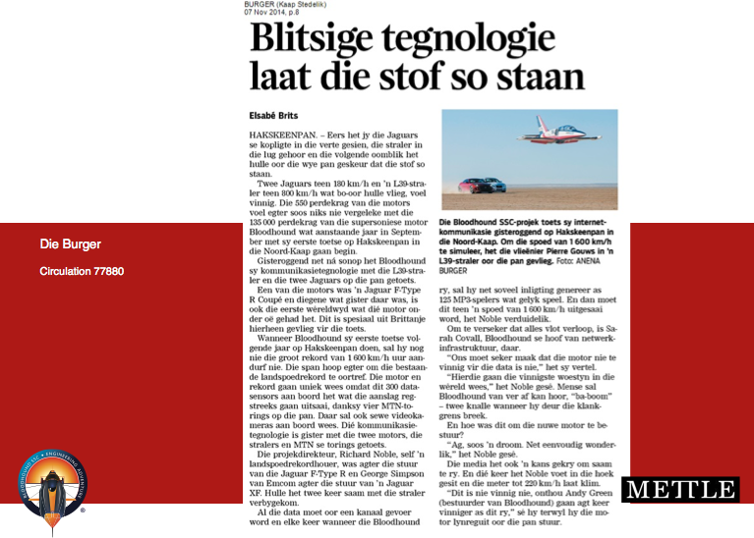

Slide 10
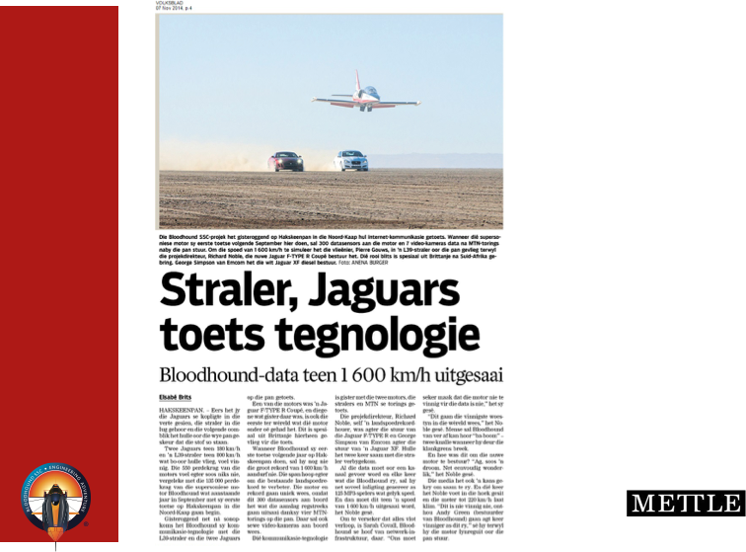

Slide 15
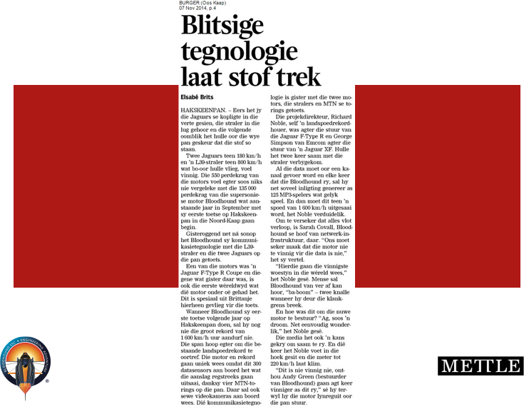

Slide 16
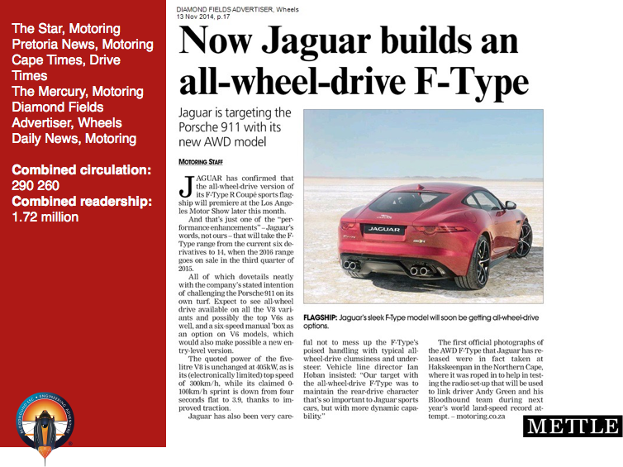

Slide 19
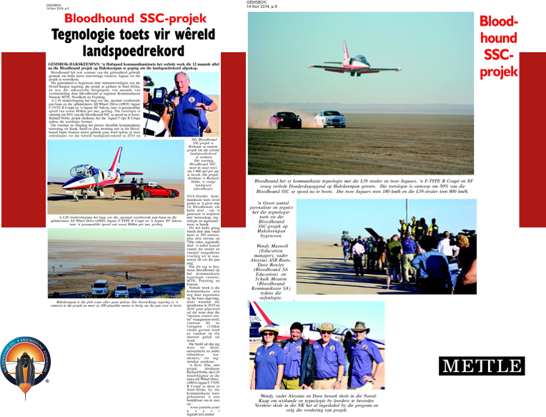

Slide 20
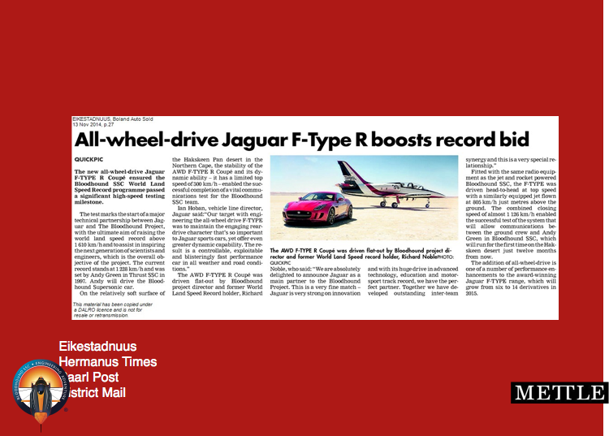

Slide 21
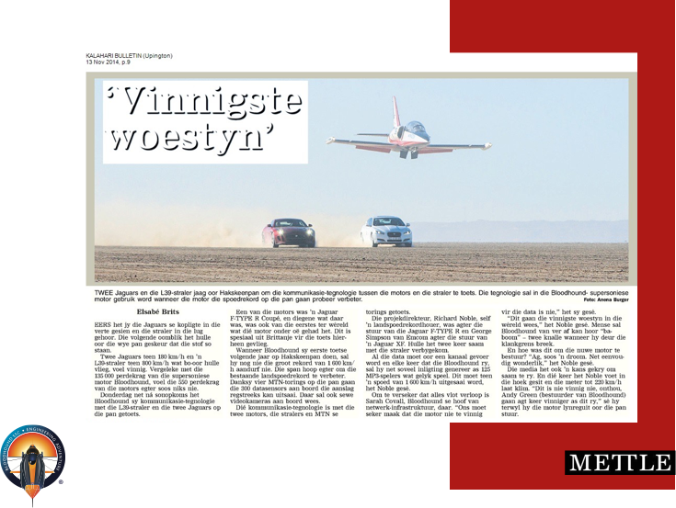

Slide 22
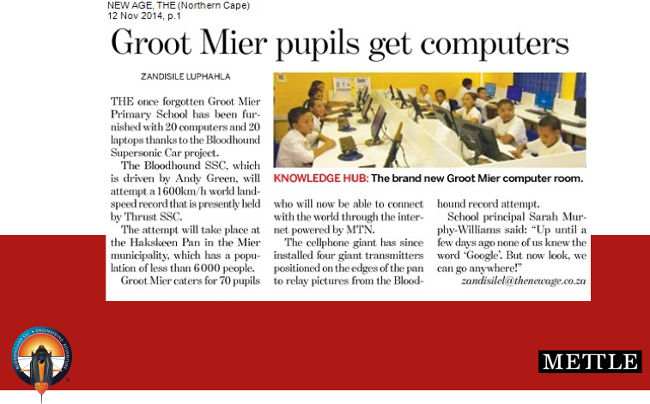

Slide 23
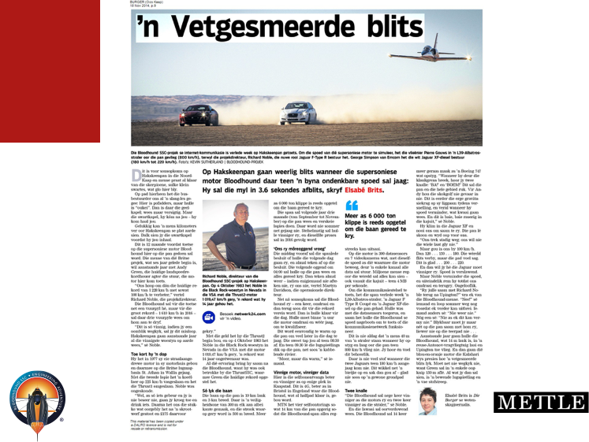

Slide 24
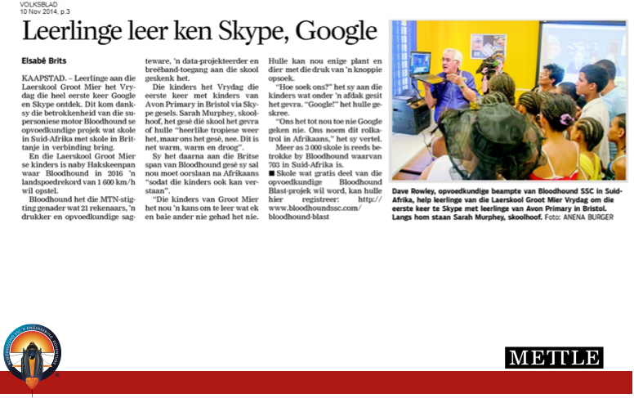

Slide 26
